Slide 1

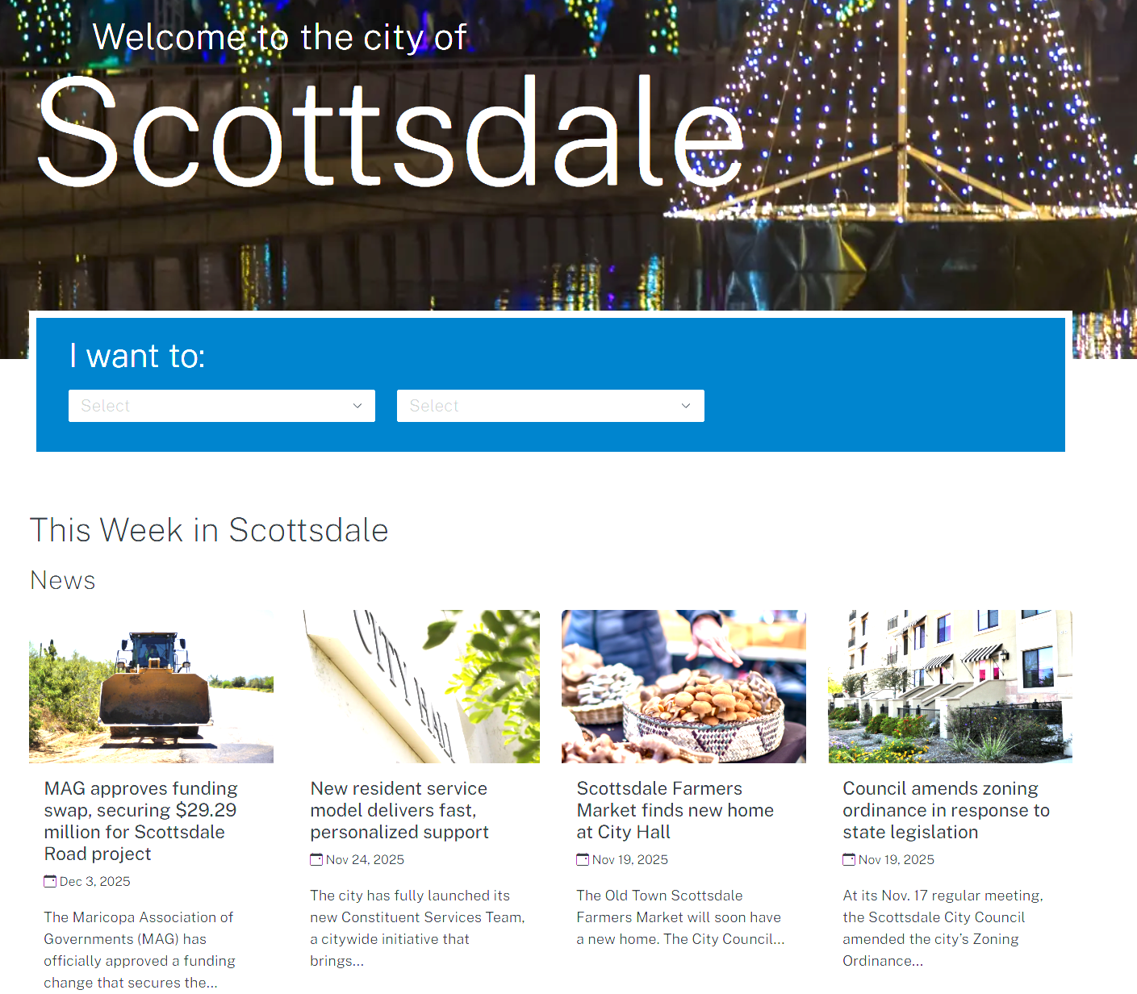
City of Scottsdale Website
Business Need
The City of Scottsdale needed a modern, user-friendly website to improve resident engagement and make city services easier to discover. Their existing site lacked mobile responsiveness, had outdated navigation, and required significant effort for staff to update content. The City partnered with Affirma to redesign the experience, implement a scalable CMS, and ensure WCAG compliance.
What We Did
Conducted discovery sessions and refined information architecture, sitemaps, and wireframes through multiple review cycles
Designed modern, responsive templates and applied branding across Sitefinity layouts, widgets, and custom components
Developed templates, configured analytics, performed WCAG AA reviews, and completed QA, UAT support, and content migration assistance
Provided Sitefinity training, documentation, and post-launch support to ensure smooth adoption and long-term maintainability.
Results
Delivered a modern, mobile-responsive website offering easier access to city services and improved citizen experience
Streamlined navigation and structured content reduced time to find key services and information
Staff gained a more efficient CMS with reusable templates and widgets, reducing effort for updates
Successful launch supported by training, analytics setup, and ongoing support ensured a stable and sustainable digital platform.

